Slide 1
Metrics and Analytics for ROI in Digital Signage
Presented by:
Alan C. Brawn & Jonathan Brawn
CTS, ISF, ISF-C, DSCE, DSDE, DSNE
Principals of Brawn Consulting
alan@brawnconsulting.com, jonathan@brawnconsulting.com

Slide 2

Can’t Measure It, Can’t Manage It
When you are involved in a digital signage system where the digital signage is being called on to directly or indirectly influence the behavior of the viewer how do you measure and quantify the performance of the system for the end user?
To date, the focus on analytics and metrics for digital signage has been about large scale national rollouts and multiple locations.
But if your digital signage system is regional or local in scale and scope, the need for performance measurements is just as significant.
Smaller scale digital signage projects need to be sold and justified on the basis of unique sets of measurements to prove ROI.
This seminar is focused on understanding the measurement tools so when the customer starts talking “metrics” and ROI, your involvement will ensure realistic expectations and a positive outcome for the project.

Slide 3

Plan on Planning
The majority of failures for those entering the dynamic digital signage industry can be directly traced to a lack of planning and due diligence up front.
The key to achieving success probability rather than possibility is to understand the major business issues that will confront you.
Here is our path today for positive and measureable results in the end:
  Digital signage markets and growth
  The 7 Key Elements of Digital Signage
  The importance of articulating the objective
  Content as the vehicle and the call to action
  Understanding ROI, ROO, and TCO
  Importance of Metrics, Measurements, and Analytics

Slide 4

Digital Signage Market Growth
Growth in the worldwide digital signage market will exceed 20%+ in 2013, totaling $7 billion USD, according to IMS Research.
In hardware, the primary revenue drivers were displays (including LED arrays), and projectors contributing US$4.5 billion.
Research shows that there is increasing recognition that digital signage is a valuable tool for directly interacting with audiences, and providing a compelling additional dimension to augment overall advertising placements across media of all types.

Slide 5
Global Digital Signage Market Value

Slide 6

Changing Behavior-The Numbers
According to a recent Arbitron study, one in three consumers stated they made an unplanned purchase after seeing a product advertised on a dynamic digital sign.
Other research, including information presented at the Digital Signage Business Conference, shows that dynamic digital signs receive up to 10 times more eye contact than traditional static signage.
According to the Washington Post, 68% of Americans see a dynamic digital sign each and every day.
The New York Times reports that we spend an average of 8 hours a day in front of one type of electronic screen or another each day.

Slide 7

Why Digital Signage is Growing
Digital signage is experiencing exponential growth and has become a popular promotional, advertising, and communication technology for end-users to implement for a variety of reasons.
Most critically, digital signage can improve the customer experience and provides the most relevant and targeted messages at the most appropriate time.
Digital signs offer a more welcoming and interesting environment directly to the consumer.
Digital signage provides the opportunity for brand building as well as a strategically influencing shopping behavior and can create a stimulating environment where the customer’s long and short-term behavior can be shaped.
Many businesses report significant sales increases due to dynamic digital signage

Slide 8
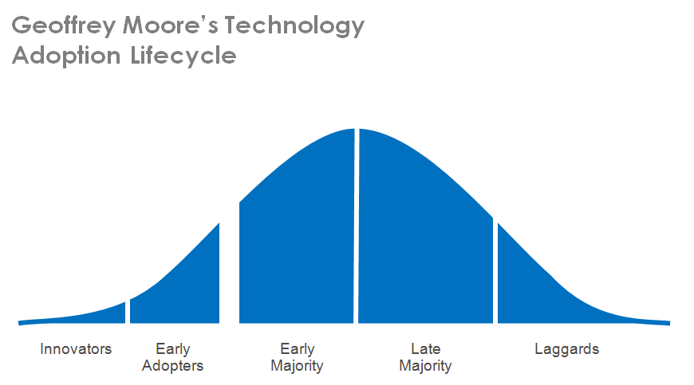
Technology Adoption Life Cycle
Here we are!

Slide 9
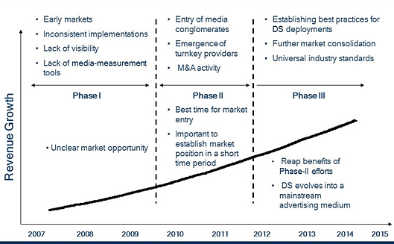
Technology Adoption Life Cycle

Slide 10

Looks Easy, But Its Not!
Digital signage is a “tangled web” of interrelated technologies, that on the surface look quite simple.
It appears to be a ubiquitous 40”+ flat panel display hung on the wall, connected via CAT5 cable to a server with content of some type resident for replay on that device.
In fact, this “commodity” product is anything but. It is a tangled web and the way that each of the sectors of digital signage interrelate to one another will determine the ultimate success or failure of the signage system.

Slide 11
The 7 Key Elements of Digital Signage

Slide 12

The 7 Key Elements of Digital Signage
Each one of The 7 Key Elements of Digital Signage is used in every single application and network.
You must know how they each relate and interact but…
The good news is that you do not need to be an expert in all of them.
In dynamic digital signage, partnering is good!

Slide 13
The 7 Key Elements of Dynamic Digital Signage
Digital Signage
Software
Connectivity
Operations
Scheduling
Player
Control
Creation
Wired
Wireless
Cellular
Internet
Network
Maintenance
Installation
Service
Support
Business
Objectives
Partnering
Revenue
Content
Media
Advertising
Marketing
Design
Deployment
Purpose
Environment
Hardware
Displays
Mounts
Players
Infrastructure
ROI, ROO

Slide 14
First Law of Analytics and Measurement:
Articulating the Objectives

Slide 15
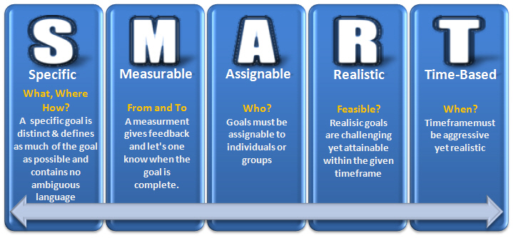
Did We Mention the Objective is #1?
The entire concept of digital signage revolves around delivering a message more effectively than a traditional static sign.
Due to this, understanding and articulating the objective of what you are trying to achieve with the signage system is critical, before you can begin the design, and select your hardware or software.
It is imperative to understand what you want the digital signage system to accomplish, and how it will be evaluated.

Slide 16
Did We Mention the Objective is #1?
The key component to deliver on and measure the success or failure of the objectives is content.
You need to know not only the kind of content that is going to be displayed, but more importantly, the intent of each segment of that content.
What is this signage system going to actually be used for? This question unlocks the direction you will need to go for software, and can help lead to what size and type of display you will be looking at.
If you do not know and articulate the true objective of the system, you cannot design an effective one.

Slide 17
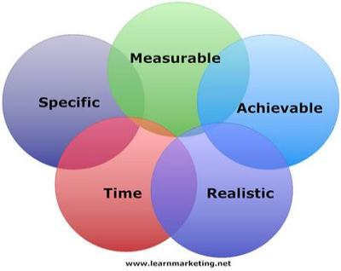
Examples of Measurable Objectives
Identify and articulate the SPECIFIC OBJECTIVES of the project.
  Brand building
  Customer experience/entertainment
  Facilitating by function
  Ad revenue generation
  Information and/or way finding
  Increasing efficiency
  Time saving
  Technical support
  Other-TBD

Slide 18
Content as the Vehicle and a Call to Action

Slide 19

Content as the Vehicle
Often times you hear that content is king. In fact, that is not correct.
Content may be thought of as the crown prince, but not the king.
The king is the objective.
Content, on the other hand, is the “vehicle” that carries the objectives to fruition.

Slide 20

Content as the Vehicle
Digital signage content is all around us and has become ubiquitous.
Today, most of us are confronted with digital signage everyday and know we spend a lot of time in front of one type of screen or another. So…content abounds but good and effective content does not.
What we have learned through trial and error over the last few years is that one size does not fit all in terms of content but simple, straightforward copy and a strong call-to-action can make the difference between a content spot that converts from inaction to action and one that doesn't.

Slide 21

Content Call-to-Action
For digital signage content to be effective, it normally requires using a persistent call-to-action whether in the form of a command, declarative statement or mere suggestion.
By asking a viewer to do a task that they can complete immediately (or at least very soon), there's a much greater chance that they'll do it.
Likewise, easier tasks are more likely to get completed than more challenging ones.
Digital signage content without a call-to-action is called entertainment!

Slide 22
Return on Investment
Return on Objectives
Total Cost of Ownership

Slide 23
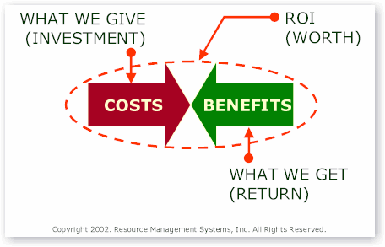
Digital Signage ROI-ROO & TCO
There is no more important topic or measurement than return on investment (ROI) and its “roommate” return on objectives (ROO).
In short, digital signage boils down to business and potential profit as well as potential loss and it MUST be calculated and planned for in a very thorough manner up front and will require constant attention and monitoring as long as the network exists.
What makes ROI and ROO so complex are the variables in digital signage.
We will begin with a basic definition and then look at the variables in order to better understand the need for proper planning

Slide 24

Digital Signage ROI-ROO & TCO
Return on investment (ROI) is a performance measurement used to evaluate the efficiency of an investment.
To calculate ROI, the benefit (return) of an investment is divided by the cost of the investment; the result is expressed as a percentage or a ratio.
Return on investment is a very popular metric because of its versatility and simplicity.
In the formula below, "gains from investment", refers to the proceeds or revenues obtained from it.
If an investment does not have a positive ROI, or if there are other opportunities with a higher ROI, then the investment should be not be undertaken.

Slide 25

Digital Signage ROI-ROO & TCO
In digital signage there are two basic business models.
First of all and most pervasive, there is the ad based model where digital signage is used as an advertising medium and the end user either uses their digital signage network to advertise their own products or services for sales purposes or they may sell advertising on their networks as a method of generating revenue from others.
Although the math is never this simple, it boils down to hard dollars invested versus hard dollars returned in the way of revenue or proceeds.

Slide 26

Digital Signage ROI-ROO & TCO
The second digital signage business model is one where information is conveyed via the digital signage network and the objective is for company communication, way finding, or another benefit to the viewer that is not normally related directly to revenue generation or selling something. This is called return on objectives or ROO.
Since there are hard dollars that need to be spent in building the digital signage network and there are no hard dollar returns to offset the expense, then an evaluation of the objectives of the network is necessary and an estimation of the “value” of meeting the objective must be compared with the investment.
Caveat: I told you it was not simple math!

Slide 27

Digital Signage ROI-ROO & TCO
If we review the formula for ROI, then we know that there is an investment cost to consider versus the revenues received or in the case of ROO, the value of meeting the objectives.
Now for the hard part and that is adding up the total cost of ownership or TCO into the equation..
In the realm of digital signage this is not a fixed number because there are recurring costs that must be added up. This includes the refreshment of content, network costs, costs of updating software, and continuing costs of service and maintenance of the network.
Only now are we totally ready to do the math and evaluate the success or failure of the digital signage network.

Slide 28
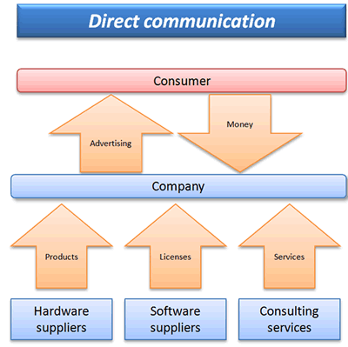
Digital Signage ROI-ROO & TCO
Lets do a short review.
We have the investment costs up front and we must also figure in the recurring costs and TCO.
We then figure in the revenue or proceeds from the dynamic digital signage network or in the case of ROO a value of meeting our objectives.
We then compare the costs to the benefits and voila, we can evaluate and measure the success of what we have done.

Slide 29
Importance of Metrics,
Measurements, and Analytics

Slide 30
The Task at Hand…
Conventional wisdom says that if a campaign delivers the right message to the right people, in the right environment at the right time, success will result.
Determining whether this formula worked or not is rarely easy because of the variables.
Measuring results often entails poring over sales figures and interviewing viewers/customers both of which can be tedious, time consuming and inaccurate.
The difficulty increases exponentially as the depth of detailed analysis required is increased.
These challenges, and more, face stakeholders in digital signage deployments.
The investors and end users considering the cost and complexity of an installation needs to be assured there is payoff in increased sales, customer experience or both.
Marketers who place ads on networks of screens want to know how many people are seeing them, and even what the demographics are of those transient audiences.

Slide 31

The Importance of Viewer Analytics
There is a continuing MBA buzz phrase that goes something like this: “If you can’t measure it, you can’t manage it”.
We will add this: “If you cannot manage it, then it is out of control”.
By measuring the viewer (analytics) the benefits go directly to the bottom line.
Analytics:
  Determine viewer demographics, measure audience behavior and optimize content
  Deliver increased ROI/ROO through greater insight into consumer behavior
  Improve business performance as well as the customer experience

Slide 32

Answering Questions with Analytics
Top 10 questions:
  How do I prove ROI to advertising/marketing agencies and their clients?
  How can I know who’s watching what?
  Are my screens at the best locations?
  Is my on-screen content meaningful?
  Is it impactful?
  How can we best communicate directly with our customers, in-store and out-of-home?
  What are they watching and/or listening to?
  How can we know who uses the information?
  Is the experience relevant?
  How do I measure it all?

Slide 33
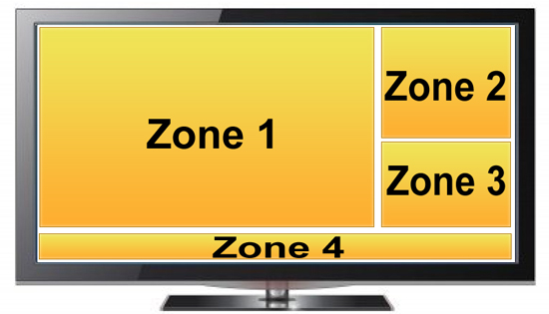
What is Being Measured
Presence — in the zone, where the screen is both visible and if applicable, audible
Notice — evidence that the screen has been noticed. The ad people call this the impression.
Dwell time — time spent by the viewer in the screen zone
By applying demographic analysis to the above three items, detailed information is gleaned as to who saw what and for how long.

Slide 34
Means of Measurements
Exit surveys/interviews
Traffic counters (mechanical or electronic trip devices)
Calculating interactive touch screen responses
Area focused video recording of viewers
Call to action results with promo/coupon response rates
Anonymous Video Analytics (AVA)
  Video measurement of DOOH messaging has 95 percent people-count accuracy, 90 percent gender-classification accuracy and 85 percent age-range-classification accuracy.
  Although AVA occasionally is referred to as facial recognition, that’s a misnomer.
  What is important to note from a privacy standpoint is that there are no images or video footage stored and each record is completely anonymous.
  Looking at a record, all you would see was there was a time, there was a count and some general demographic characteristics.
  You wouldn’t have any information beyond that and you couldn’t link it back to a specific individual.

Slide 35

It is All About Knowing the Audience
Demographic research enables you to know your audience and effect the bottom-line by being able to measure and monetize screen ROI and ROO from digital signage, advertising, marketing and communications.
The right content will be matched to specific demographic groups and this will tell you how frequently to change it
Knowing the audience will dictate the optimal location of a digital sign.
Conversion ratios and uplift from campaigns and promotions will confirm ROI and ROO.
Deeper insights into viewer behavior that comes from quantitative demographic and behavioral data provides better ways to spend valuable budget dollars

Slide 36

Light at the End of the Tunnel
The challenge is not without a solution.
A fairly recent development, the science of anonymous video analytics, has emerged to provide the means to acquire such data through sophisticated hardware and software applications.
Various forms of analytics exist, breaking down consumer activity and behavior. This technology gives businesses a more detailed look at individuals who come in contact with digital signage.
Through cameras installed on and integrated into monitors, software can show everything from the length of time someone watches an ad or message to exactly who watches, and correlate the effectiveness of those spots.
Analytics provide pivotal information that helps signage operators know the answers to the questions noted earlier.

Slide 37
What Matters!
Digital signage network operators and end user companies do not don’t want a message merely to be seen. The ad agencies call this an impression and for our purposes that is useless.
They want it to be seen, remembered, and most important, acted upon. Otherwise, if consumers pass by just seeing that the screen and images exist, they are wasting both time and money.
Anonymous Video Analytics (AVA) distinguishes how much attention people “spend/invest” in the digital signage experience. Technically speaking, as someone approaches a monitor, cameras focus in, capturing a digitized impression of the viewer. Actual images are not used, thus keeping data anonymous.
Through those impressions, the technology is able to discern a person’s gender, race, approximate age and, based on the contours of the person’s face and positioning, just how long he actually looks at the screen. This measurement takes less than 10 seconds.

Slide 38

Use of Data Gathered
Data gathered from AVA empowers businesses to make a host of changes in relatively short order. As an example, messages or ads that are effective with customers can be identified immediately, based on the times of the day and frequency of the ads for a particular item.
Much more data (read that detail) is gleaned in this manner and no longer do the network operators or end user companies have to wait days or weeks for such data.
According to Intel, a leader in this type of technology, “These new analytical reports can result in reconfiguring store designs or repositioning products that cater to the interest of their consumers. They also can determine specifics about their clientele at various periods of the sales day and target ads and messages to them regarding certain products, services or promotions. Analytics produce information about individual units anchored around a location or about the entire network in real time, allowing businesses to pinpoint spots within the store to reach customers.”

Slide 39

More Than Sales Numbers
Analytical programming isn’t simply tallying sales figures, but also giving information to signage operators to allow them to go beyond straightforward numbers.
They can use figures to better mark slower and peak sales periods, and thus adjust staff accordingly.
The ability for businesses to use analytics to quantify sales in greater detail, such as who is buying what and when, is just the sort of enticement advertisers need to decide whether to invest in the growing digital market.
Some of those in the digital signage industry believe the use of analytics through such media is in its infancy. Where they see it providing the greatest impact is through optimization, using measurements via analytics to further build all facets of business.

Slide 40
Final Recommendations

Slide 41

Final Recommendations
Success in digital signage is first and foremost about the business model that is adopted in the beginning!
You must understand, articulate, and agree upon the objective
Take into consideration the criteria for judgment
One size does not fit all. Customize for a “good fit”.
Understand what the system can and cannot do.
Remember there is a difference between price and cost.
Recurring costs must be considered up front
Concentrate on true “value” with metrics and measureable ROI and/or ROO.
Form meaningful partnerships for products and solutions.
K.I.S.S
Keep it stupidly simple!

Slide 42
Q&A

Slide 43



For More Information
If you would like more information, please contact the Digital Signage Experts Group:
http://www.brawnconsulting.com
http://www.dseg.org
http://www.isfcommercial.com
Alan C. Brawn, CTS, ISF, ISF-C, DSCE, DSDE, DSNE
  alan@brawnconsulting.com
Jonathan Brawn, CTS, ISF, ISF-C, DSCE, DSDE, DSNE
  jonathan@brawnconsulting.com

